Slide 1
Introduction to Cryptography

Slide 2

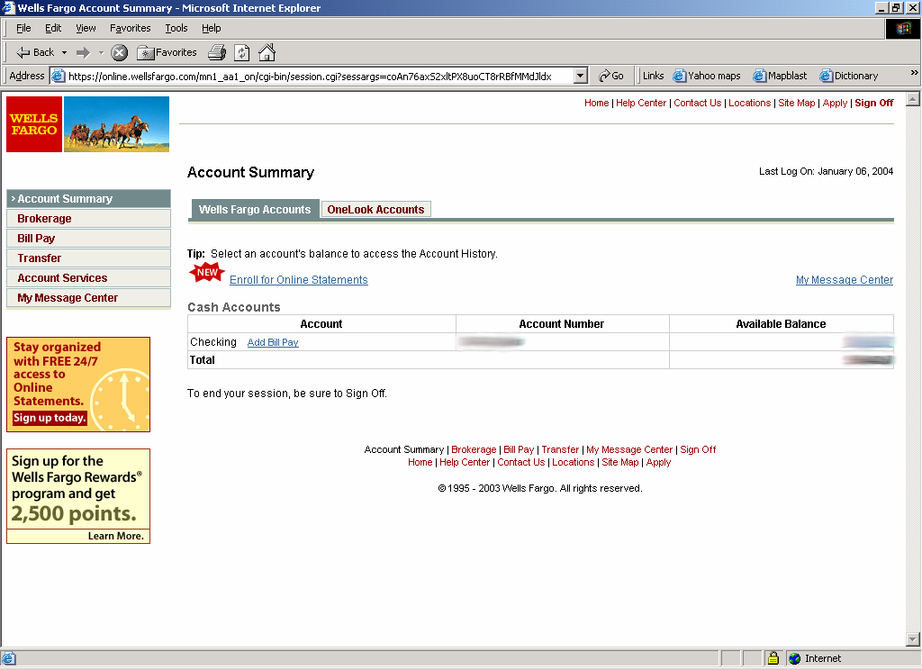

Goal: Secure communication
Uh hum, no way???
no eavesdropping
no tampering
Notes:
1. ensure security of communication over insecure medium

Slide 3



Goal: Protect Alice’s Communications with Bob
Oh! I cannot see it, whaaaat?
Bob

Slide 4
What is Cryptography
Study of techniques for secure communication in the presence of third parties
Enables us to store sensitive information or transmit it across insecure networks so that it cannot be read by anyone except the intended recipient
The science of using mathematics to encrypt and decrypt data
Notes:
Study of mathematical techniques to achieve various goals in information security, such as confidentiality, authentication, integrity, etc.

Slide 5




Goal: Protect Alice’s Communications with Bob
plaintext
plaintext
Encryption
Algorithm
Decryption
Algorithm
Alice
Bob
+
ciphertext
+
encryption key
decryption key
Secret key refers to a sequence of symbols or a numerical value:
Used by an algorithm to alter information & making that information secure
Used by an algorithm to transform back message to its original form

Slide 6
Terminology
Encryption and Decryption
Encryption: a process of encoding a message so that its meaning is not obvious
Decryption: the reverse process
Plaintext vs. Ciphertext
P(plaintext): the original form of a message
C(ciphertext): the encrypted form

Slide 7
Terminology
Basic operations
plaintext to ciphertext: encryption: C = E(P,K)
ciphertext to plaintext: decryption: P = D(C,K1)
requirement: P = D(E(P,K),K1)
plaintext
ciphertext
plaintext
Encryption
Algorithm
Decryption
Algorithm
Alice
Bob

Slide 8
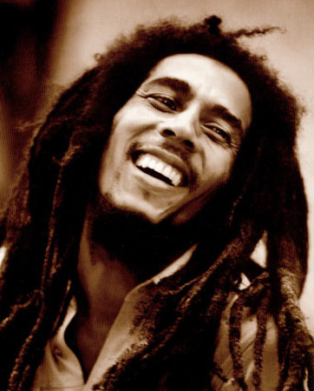

M
Alice
M
Bob
Eve
Goal 1: Confidentiality
Eve should not be able to read M.

Slide 9

M
Message:
I love you
Message:
I hate you
M
Alice
Bob
Ha! Bob should feel sad
Eve
Goal 2: Integrity
Eve should not be able to alter M.

Slide 10
M
Alice
M
Bob
Eve
Goal 3: Authenticity
Eve should not be able to forge messages as Alice
Notes:
Message authenticity means that you can establish that the message originated from a trusted entity. For this reason message authenticity often implies integrity.
We cannot have data authenticity without integrity. If I write a letter and the mailman changes a letter in the letter I wrote, then the letter I wrote is no longer authentic since it is not the same letter I sent; it is now, in a way, a new letter created by the mailman.
Authenticity helps to reduce instances of fraud by way of misrepresentation. For further authenticity purposes, it is also important to verify that all parties in a transaction are who they really claim to be.

Slide 11
Cryptography Goals
M
Public Channel
Alice
M
Bob
Eve
Cryptography Goals: Confidentiality, Integrity, and Authenticity

Slide 12
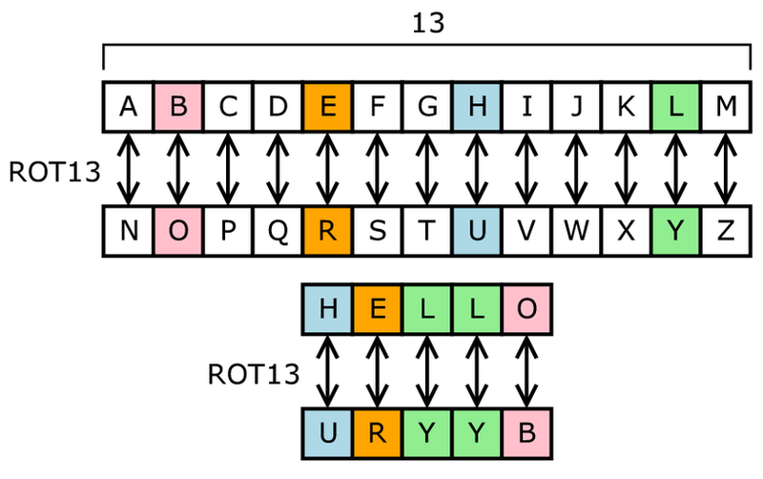
Caesar Cipher (or Shift Cipher)
Each letter is uniquely replaced by another
One popular substitution “cipher” for some Internet posts is ROT13.

Slide 13
Caesar Cipher (or Shift Cipher)
Substitution cipher
Let messages be all capital letter case from A through Z (no spaces or punctuation).
Represent letters by numbers from 0 to 25.
Encryption function
C_{i} = E(P_{i} ) = P_{i} + K (mod 26)
where K is secret key
Decryption is
P_{i} = D(C_{i} ) = C_{i} - K (mod 26)

Slide 14
Caesar Cipher: c = ( m + 5 ) mod 26
A | B | C | D | E | F | G | H | I | J | K | L | M | N | O | P | Q | R | S | T | U | V | W | X | Y | Z
F | G | H | I | J | K | L | M | N | O | P | Q | R | S | T | U | V | W | X | Y | Z | A | B | C | D | E
m = LOVEANDHONOR
C = QTAJFSIMTSTW

Slide 15
How would you attack messages encrypted with a Caesar cipher?

Slide 16
Attacking Caesar Cipher
Easy to brute force: size of key-space is 26
Try all possible keys K and determine if DK(C) is a likely plaintext
Requires some knowledge of the structure of the plaintext (e.g., PDF file or email message)
Key should be a sufficiently long random value to make exhaustive search attacks unfeasible

Slide 17
1 => PSZIERHLSRSV
2 => ORYHDQGKRQRU
3 => NQXGCPFJQPQT
4 => MPWFBOEIPOPS
5 => LOVEANDHONOR
6 => KNUDZMCGNMNQ
7 => JMTCYLBFMLMP
8 => ILSBXKAELKLO
9 => HKRAWJZDKJKN
10 => GJQZVIYCJIJM
11 => FIPYUHXBIHIL
12 => EHOXTGWAHGHK
13 => DGNWSFVZGFGJ
14 => CFMVREUYFEFI
15 => BELUQDTXEDEH
16 => ADKTPCSWDCDG
17 => ZCJSOBRVCBCF
18 => YBIRNAQUBABE
19 => XAHQMZPTAZAD
20 => WZGPLYOSZYZC
21 => VYFOKXNRYXYB
22 => UXENJWMQXWXA
23 => TWDMIVLPWVWZ
24 => SVCLHUKOVUVY
25 => RUBKGTJNUTUX

Slide 18
Monoalphabetic Substitution
L | O | V | E | A | N | D | H | O | N | O | R
A | B | C | D | E | F | G | H | I | J | K | L | M | N | O | P | Q | R | S | T | U | V | W | X | Y | Z
P | O | L | Y | T | E | C | H | N | I | U | V | R | S | B | K | W | A | D | F | G | J | M | Q | X | Z
V | B | J | T | P | S | Y | H | B | S | B | A
Notes:
Caesar cipher is one type of monoalphabetic cipher. This means that each plaintext letter is encoded to the same cipher letter or symbol.
The main weakness of monoalphabetic ciphers is that although the letters themselves change, their frequency does not. So, any enthusiastic cryptographer could crack the code using frequency analysis tables of the original plaintext language. This method was first documented by an Arabic mathematician Abu al-Kindi in the 9th century.

Slide 19
Try one
http://highschool.spsd.org/crypt/pigpen.html

Slide 20
How would you attack messages encrypted with a substitution cipher?

Slide 21
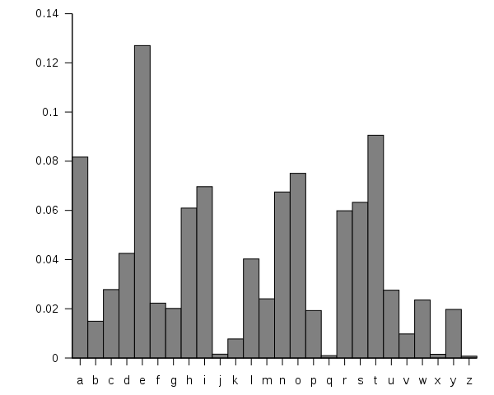
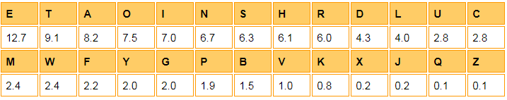
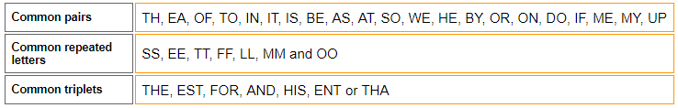
Attacking Substitution Ciphers
Trick 1:
Word Frequency
Most common: e,t,a,o,i,n Least common: j,x,q,z
Trick 2:
Letter Frequency
Notes:
Frequency analysis is the study of letters or groups of letters contained in a ciphertext in an attempt to partially reveal the message.
Knowing the usual frequencies of letters in English communication, if the encryption method does not effectively mask these frequencies it is possible to statistically determine parts of the plaintext from looking at the ciphertext alone.
Let’s look at an example based on a plaintext encrypted with the Caesar Cipher – a cipher that provides no protection from frequency analysis.
Substitution ciphers preserve the language features.
Substitution ciphers are vulnerable to frequency analysis attacks.
In addition to this, English also has a number of common letter patterns that we can also use to help decrypt monoalphabetic ciphers:
The method of decryption using frequency analysis has two stages:
Work out the frequencies of letters or symbols in the ciphertext and compare the results to the letter frequencies in the language � e.g., we know �e� is the most common letter in English, and �the� is the most frequent word.
Make intelligent guesses for words or letters � e.g., a lone letter in English will be �I� or �A�. This method is time consuming, and is less accurate for short messages, but is a valuable aid to the cryptographer.

Slide 22
TYPICAL ENGLISH TEXT CIPHER TEXT (shifted up by 4)
A : 0.08167 E : 0.08360
B : 0.01492 F : 0.01311
C : 0.02782 G : 0.01967
D : 0.04253 H : 0.04096
E : 0.12702 I : 0.10983
F : 0.02280 J : 0.02131
G : 0.02015 K : 0.03442
H : 0.06094 L : 0.06229
I : 0.06966 M : 0.07049
J : 0.01530 N : 0.00000
K : 0.07720 O : 0.00327
L : 0.04025 P : 0.02131
M : 0.02406 Q : 0.02131
N : 0.06749 R : 0.08524
O : 0.07507 S : 0.07540
P : 0.01929 T : 0.03278
Q : 0.00950 U : 0.00000
R : 0.05987 V : 0.05737
S : 0.06327 W : 0.06557
T : 0.09056 X : 0.10819
U : 0.02758 Y : 0.01803
V : 0.00978 Z : 0.00327
W : 0.02360 A : 0.02786
X : 0.00150 B : 0.00000
Y : 0.01974 C : 0.02459
Z : 0.00074 D : 0.00000
Notes:
1. if we “shift” the entire column of the frequency of our ciphertext up, we get the following table.

Slide 23
Polyalphabetic Substitution – Vigenere Cipher
Idea: Uses Caesar's cipher with various different shifts, in order to hide the distribution of the letters.
A key defines the shift used in each letter in the text
A key word is repeated as many times as required to become the same length
Plain text: I a t t a c k
Key: 2 3 4 2 3 4 2 (key is “234”)
Cipher text: K d x v d g m

Slide 24
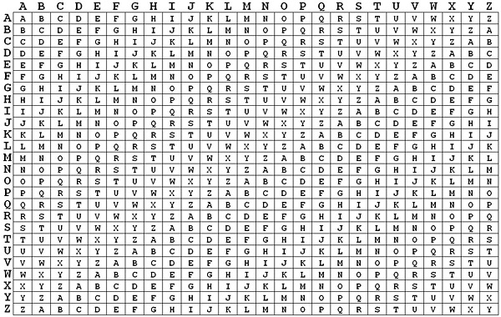
"KEY" -> Encode "hello"
Select column with letter we are encoding "h"

Slide 25
"KEY" -> Encode "hello"
Select ROW with current letter of key "k"
Intersection is cipher text

Slide 26
"KEY" -> Encode "hello"
Select Row with letter 2 "e" and second letter of key "e"
Cipher text is i

Slide 27
"KEY" -> Encode "hello"
To decrypt. Select column with key letter

Slide 28
"KEY" -> Encode "hello"
Look in THIS column and find letter (look for r)
Column header is the plain text "H"
find letter of ciphertext

Slide 29
Try it
https://www.dcode.fr/vigenere-cipher
http://highschool.spsd.org/crypt/vigenere.html

Slide 30
How would you attack messages encrypted with a Vigenere cipher?

Slide 31
Problem of Vigenere Cipher
Assume we know the length of the key. We can organize the ciphertext in rows with the same length of the key.
Then, every column can be seen as encrypted using Caesar's cipher.
Plain text: I a t t a c k
Key: 2 3 4 2 3 4 2 (key is “234”)
Cipher text: K d x v d g m
I a t
t a c
k
Notes:
1. A little harder to break but frequency analysis is possible

Slide 32
One Time Pad

Slide 33
One-Time Pad
Extended from Vigenere cipher
There is one type of substitution cipher that is absolutely unbreakable.
The one-time pad was invented in 1917 by Joseph Mauborgne and Gilbert Vernam
We use a block of shift keys, (k₁, k₂, . . . , k_{n}), to encrypt a plaintext, M, of length n, with each shift key being chosen uniformly at random.
Since each shift is random, every ciphertext is equally likely for any plaintext.
Notes:
Extension – because it fixes the vulnerability of the Vigenere cipher by using very long keys
Key is a random string that is at least as long as the plaintext
Encryption is similar to shift cipher

Slide 34
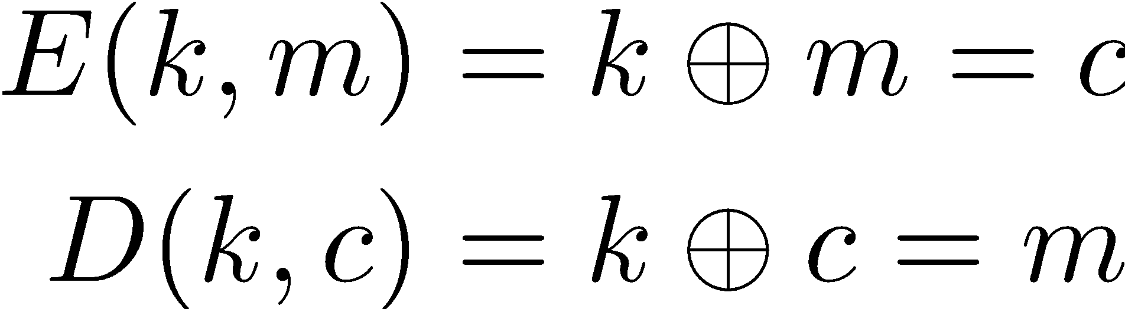

The One Time Pad
Miller, 1882 and Vernam, 1917
M = C = K = {0,1}^{n}
m: | 0 | 1 | 1 | 0 | 1 | 1 | 0
k: | 1 | 1 | 0 | 1 | 0 | 0 | 0
c: | 1 | 0 | 1 | 1 | 1 | 1 | 0
k: | 1 | 1 | 0 | 1 | 0 | 0 | 0
m: | 0 | 1 | 1 | 0 | 1 | 1 | 0
Notes:
XOR; exclusive or
Exclusive or or exclusive disjunction is a logical operation that outputs true only when inputs differ (one is true, the other is false)

Slide 35
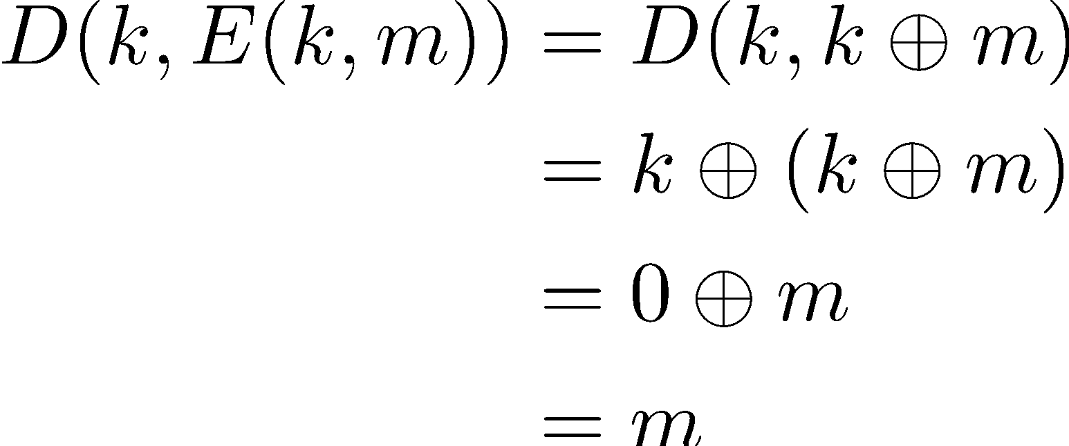
The One Time Pad
Miller, 1882 and Vernam, 1917
Is it a cipher?
Efficient
Correct

Slide 36
Example: The One Time Pad
Please encrypt “ONETIME”
Message: ONETIME
O: 01001111
N: 01001110
E: 01001010
T: 01010100
I: 01001001
M: 01001101
E: 01001010
Encoded: 01001111 01001110 01001010 01010100 01001001 01001101 01001010
Notes:
A common method of encoding letters in binary is the America Standard Code for Information Interchange (ASCII) protocol.

Slide 37
Example: Encryption with The One Time Pad
We use the following as the one-time pad (key):
11010111 11100101 10001111 00110000 10100010 00001010 01000000
Plaintext: 01001111 01001110 01000101 01010100 01001001 01001101 01000101
OneTimePad: 11010111 11100101 10001111 00110000 10100010 00001010 01000000
Ciphertext: = 10011000 10101011 11001010 01100100 11101011 01000111 00000101
Notes:
To encrypt the message using this pad, we exclusive-or each bit of the message with each bit of the one-time pad.

Slide 38
Example: Decryption with The One Time Pad
We decrypt:
Ciphertext: 10011000 10101011 11001010 01100100 11101011 01000111 00000101
OneTimePad: ^ 11010111 11100101 10001111 00110000 10100010 00001010 01000000
Plaintext: = 01001111 01001110 01000101 01010100 01001001 01001101 01000101
Notes:
Decryption process is same as encryption, i.e. we perform the exclusive-or of the ciphertext and the one-time pad, which gives us the original message. This works because X^X = 0 (i.e. the exclusive-or of something with itself is 0).

Slide 39
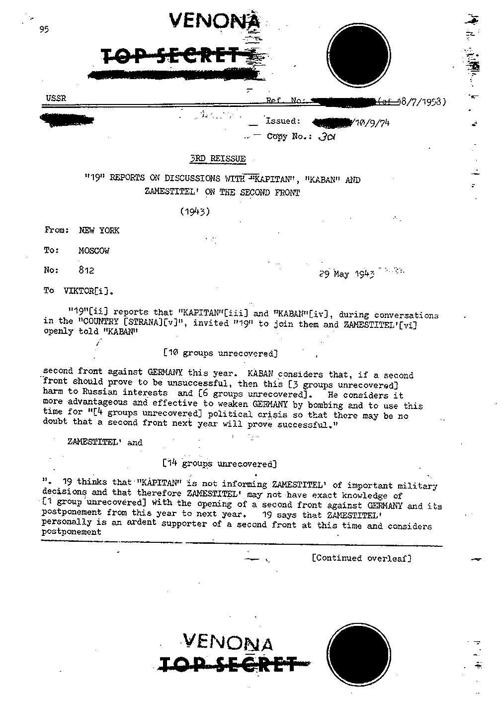
Weaknesses of the One-Time Pad
In spite of their perfect security, one-time pads have some weaknesses
The key has to be as long as the plaintext
Keys can never be reused
Repeated use of one-time pads allowed the U.S. to break some of the communications of Soviet spies during the Cold War.
Public domain declassified government image from
https://www.cia.gov/library/center-for-the-study-of-intelligence/csi-publications/books-and-monographs/venona-soviet-espionage-and-the-american-response-1939-1957/part2.htm

Slide 40
The “Bad News” Theorem
Theorem: Perfect secrecy requires |K| >= |M|

Slide 41
Enigma
The Enigma machine is a cipher device developed and used in the early- to mid-20th century to protect commercial, diplomatic, and military communication. It was employed extensively by Nazi Germany during World War II, in all branches of the German military. The Enigma machine was considered so secure that it was used to encipher the most top-secret messages.^{[1]}
The Enigma has an electromechanical rotor mechanism that scrambles the 26 letters of the alphabet. In typical use, one person enters text on the Enigma's keyboard and another person writes down which of 26 lights above the keyboard illuminated at each key press. If plain text is entered, the illuminated letters are the encoded ciphertext. Entering ciphertext transforms it back into readable plaintext. The rotor mechanism changes the electrical connections between the keys and the lights with each keypress.
The security of the system depends on machine settings that were generally changed daily, based on secret key lists distributed in advance, and on other settings that were changed for each message. The receiving station would have to know and use the exact settings employed by the transmitting station to successfully decrypt a message.
cite

Slide 42
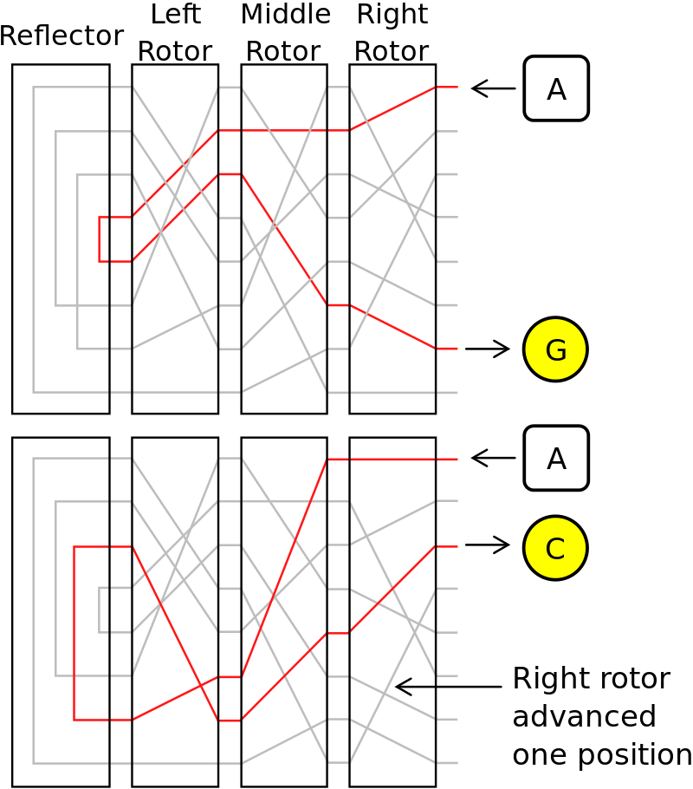
cite

Slide 43
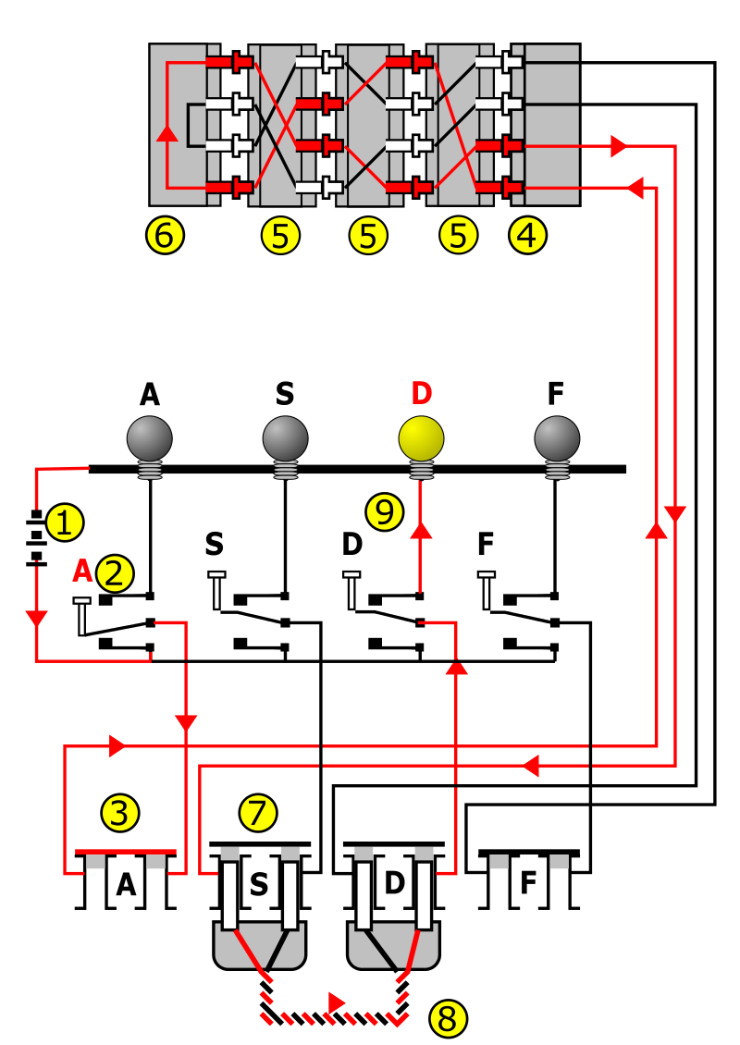

Slide 44
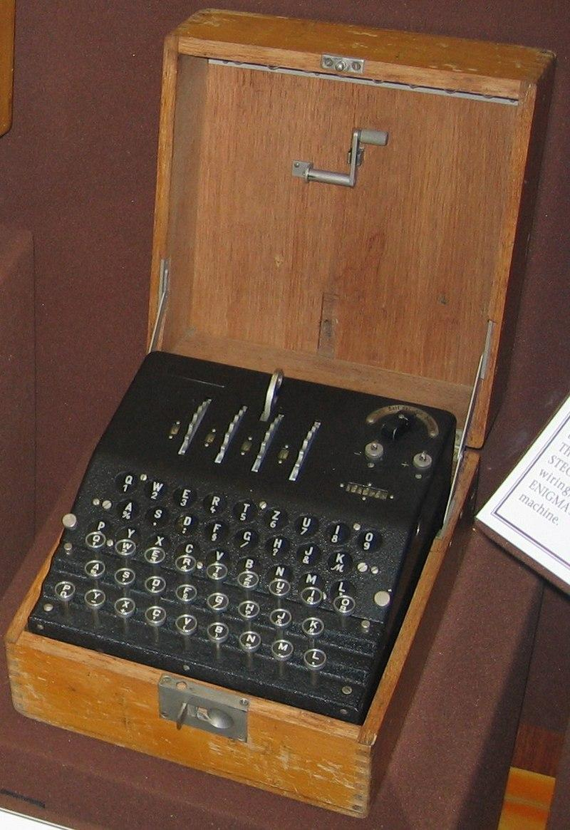
cite

Slide 45
Cryptoanalysis
Lead initially by Polish Cryptographers
Brute force. Looked for the common word "eins"
"cribs" -> known plaintext.
regular weather reports
"Nothing to report"
Recruited mathematicians
Relied on spy's and captured code books
Allies found weatherships were relatively unprotected and vulnerable to attack.

Slide 46
Bombe
The bombe (UK: /bɒmb/) was an electro-mechanical device used by British cryptologists to help decipher German Enigma-machine-encrypted secret messages during World War II.^{[1]} The US Navy^{[2]} and US Army^{[3]} later produced their own machines to the same functional specification, albeit engineered differently both from each other and from Polish and British bombes.
The bombe was designed to discover some of the daily settings of the Enigma machines on the various German military networks: specifically, the set of rotors in use and their positions in the machine; the rotor core start positions for the message—the message key—and one of the wirings of the plugboard.^{[8][9][10]}
cite

Slide 47
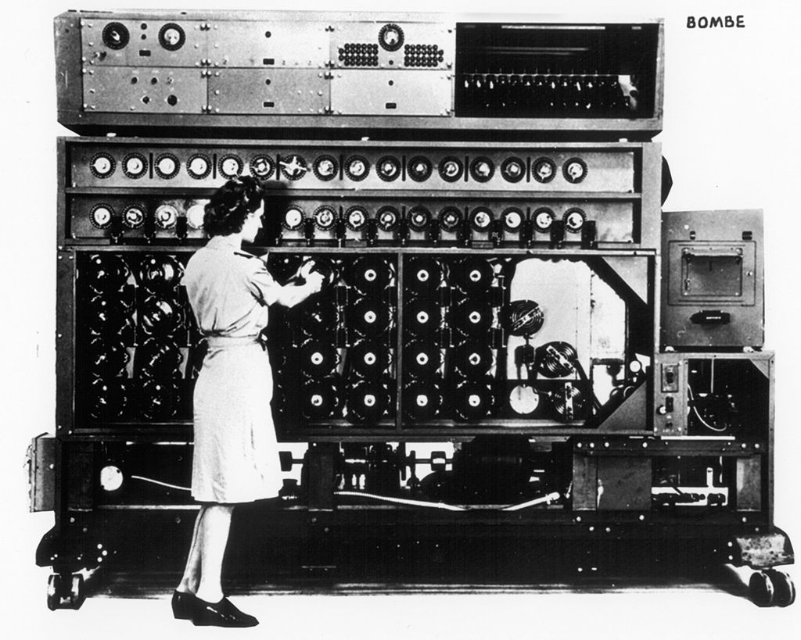
cite

Slide 48
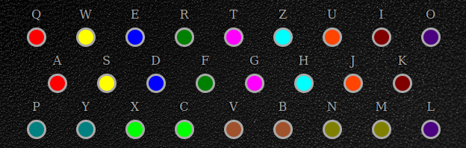
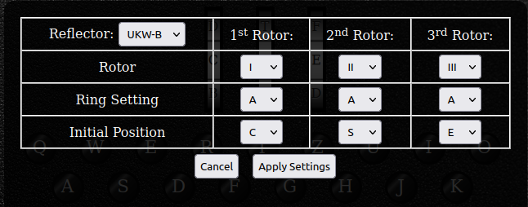
emulator
Plugboard (q->a w->s e->d r->f t->g z->h u->j i->k o->l m->n b->v c->x y->p)
Click on pairs to plug
Rotor Settings (Click on rotors to set)
Here is cipher-text
FBURV APAQD
(click on keyboard to enter cipher-text)

Slide 49
Summary
Cryptography is a awesome tool
But not a complete solution to security
Authenticity, Integrity, Secrecy
Perfect secrecy and OTP
Good news and Bad News

Slide 50
Reading
http://web.cs.ucdavis.edu/~rogaway/classes/227/spring05/book/main.pdf (Chapter 1 - 2)
http://cacr.uwaterloo.ca/hac/
https://www.cs.uri.edu/cryptography/index.htm

